Slide 1

Predicting Loan Default
Patricio Martinez, Logan Van Dine, and Victoria (Tori) Widjaja

Slide 2
Business Problem
Financial Risk: Multifamily loan defaults pose significant risks to
lenders and the housing market.
Fannie Mae Impact:
$52.9 billion in Unpaid Principal Balance for multifamily loans in 2023.
Serious delinquency rate peaked at 0.54% in September 2023.
Delinquency rate was reduced to 0.46% by year-end through foreclosure and loss mitigation.
Need for Prediction:
Early and accurate default prediction is crucial to reduce financial losses.
Aim: Develop a predictive model to identify loans at risk of becoming 60+ days delinquent.

Slide 3
Fannie Mae Data
Source: Fannie Mae’s public Data Dynamics repository
Data Overview:
Initially, 4,628,626 records were reduced to 56,643
Data types: Numeric, categorical, and date
Acquired Time frame: January 2000 to December 2023
Target variable:
“Loan Ever 60+ Days Delinquent” (binary)
Data Cleaning:
Eliminated features unavailable at acquisition to prevent information leakage
Removed data acquired in 2020 or later
Notes:
Focused on predicting loan delinquency using real-world conditions at the time of loan issuance.

Slide 4
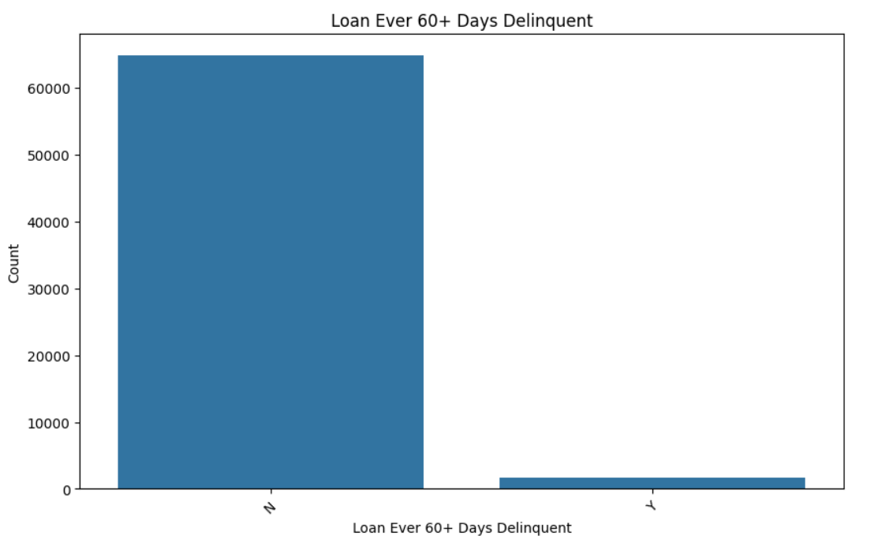
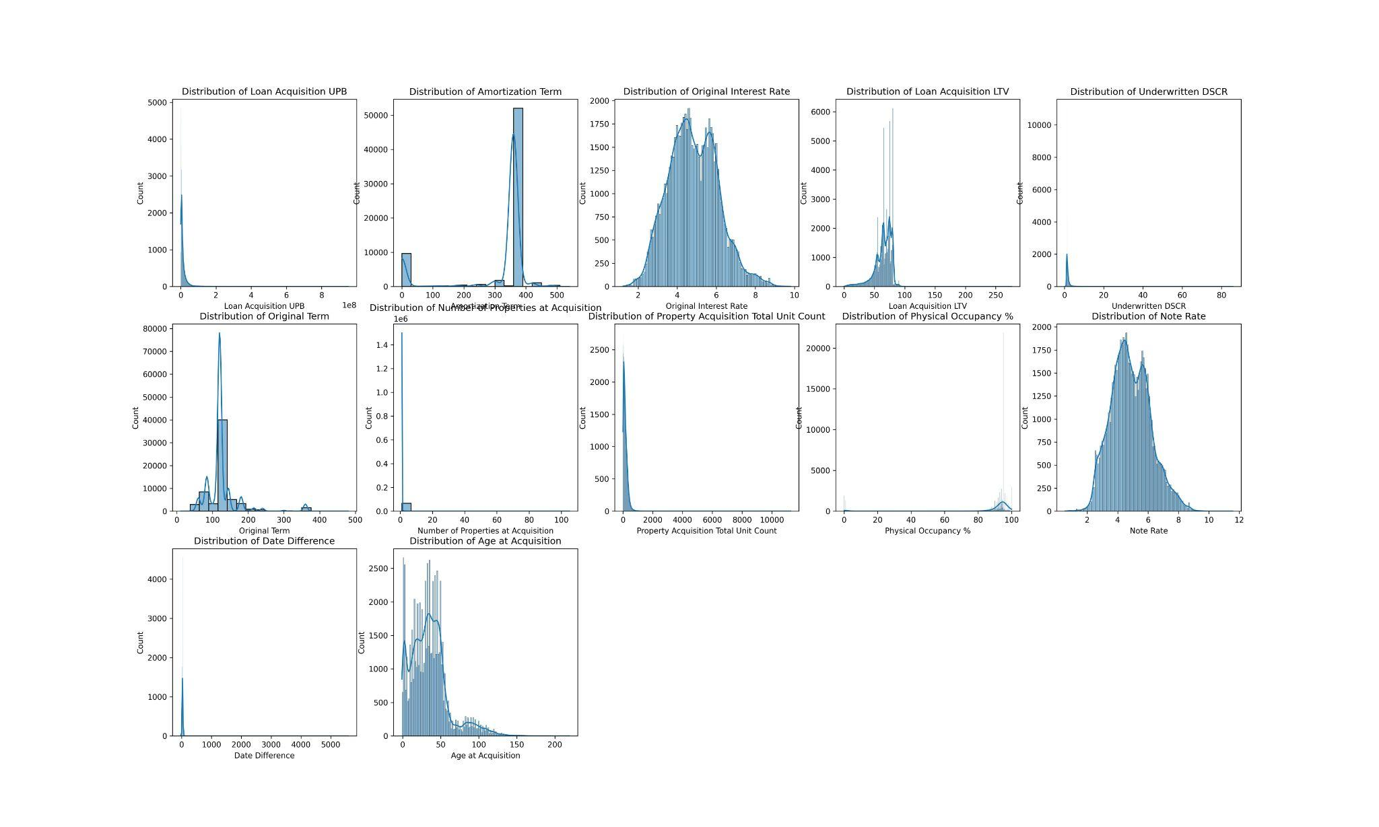
Exploratory Data Analysis - Distributions
Unbalanced Target Feature
Positively Skewed Numeric Features
Notes:
To begin exploring the data thoroughly, the team delves deeper into distributions of the target feature, “Loan Ever 60+ Days Delinquent”, and numeric features. As pictured in the leftmost visualization presented, it is clear that the target feature is highly unbalanced. An unbalanced target variable poses a severe risk of bias to the majority class, in this case, the negative class, in model performance. The team’s exploratory data analysis has already led to potential preprocessing techniques, such as smote, to balance this target.
Similarly, the rightmost visualization represents the distributions of all numeric features in the data set. There are only two features that appear to be equally distributed, while others are more commonly right skewed, or positively skewed. Again, preprocessing steps will have to be introduced to guarantee a clean, equally distributed dataset before modeling.

Slide 5
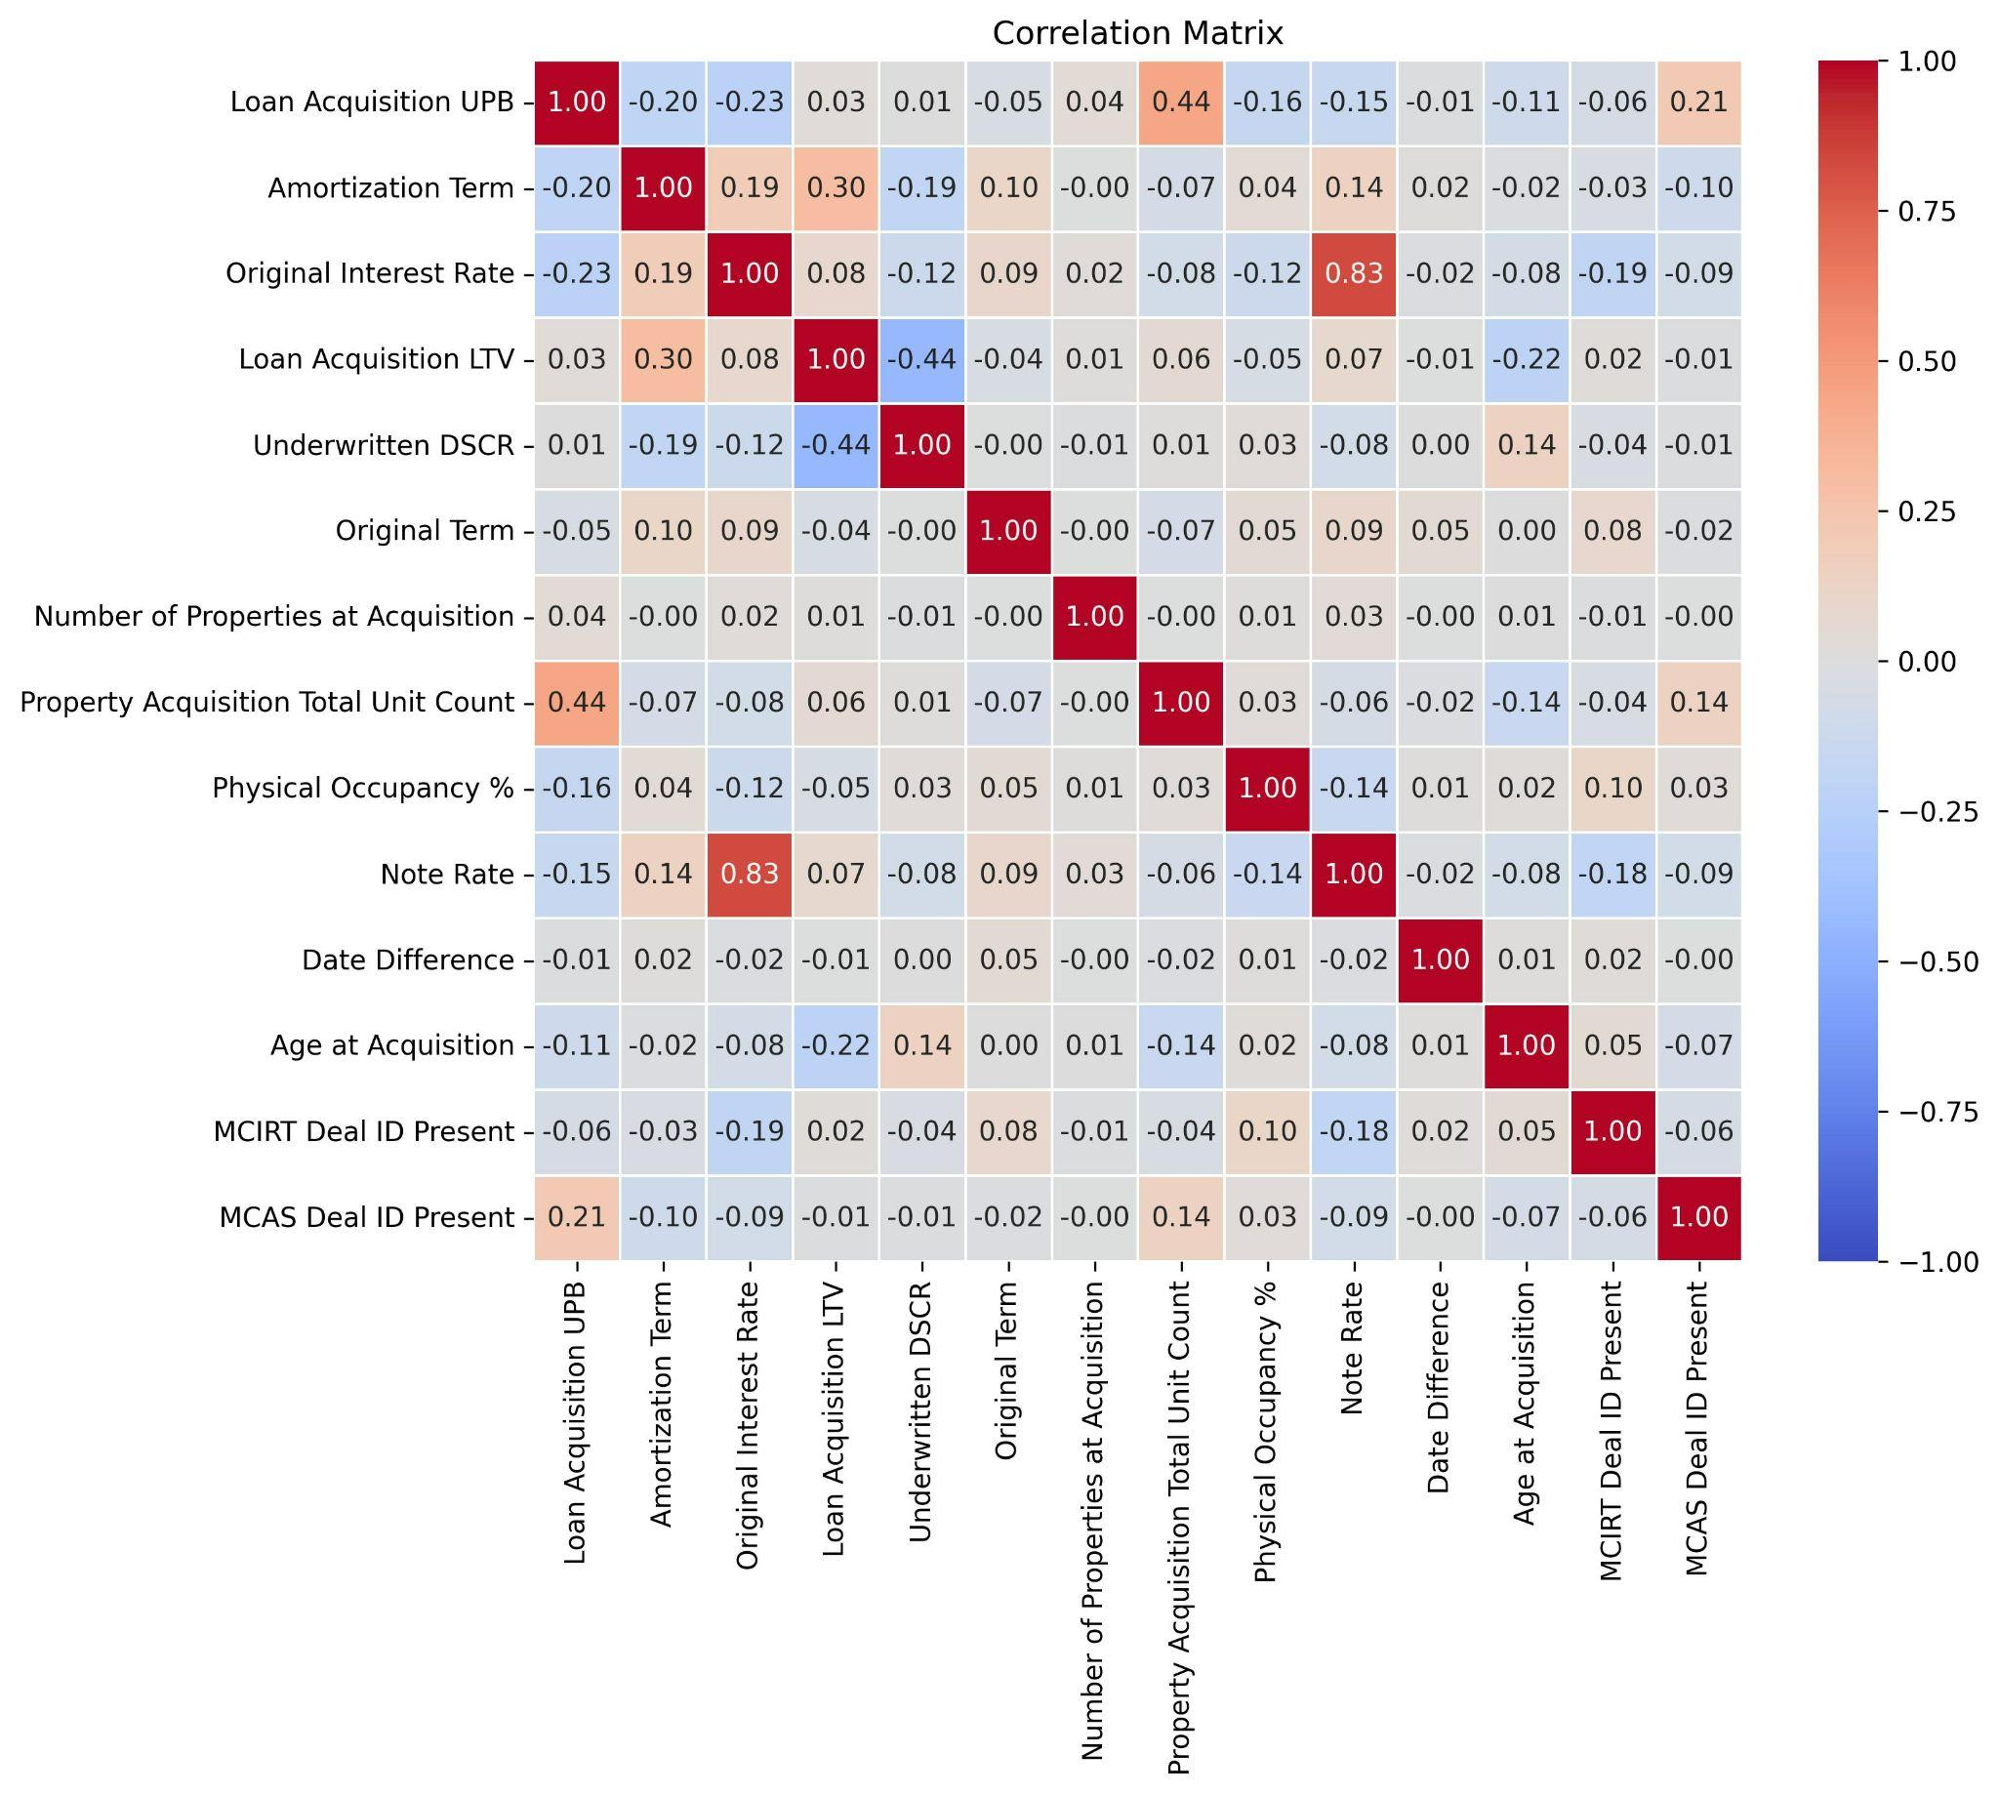
Exploratory Data Analysis - Correlation of Features
One notably strong relationship
Multicollinearity risk
Notes:
The next step of the EDA process of Fannie Mae data includes a correlation test ; completed to determine if multicollinearity, or variables too closely related, are potential risks in model development. The visualization recorded after running the correlation coefficient test can be seen here. There is one notably strong relationship, that of original interest rate and note rate, with a coefficient of 0.83. While one strong relationship does not pose an alarming risk, the team will further analyze these variables to determine if they are both necessary to include in model training.

Slide 6
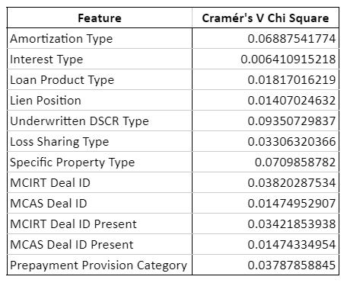
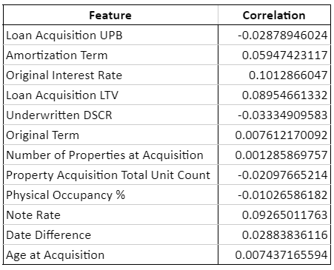
Exploratory Data Analysis - Correlation to Target
Categorical Features
Numeric Features
Cramer’s V Chi-Square Test
Biserial Correlation
Notes:
In order to further analyze the relationships of the predicting features, two tests have been completed to measure the strength of the relationship between categorical and numeric variables and the target feature of this study. To properly test categorical features in relation to the target feature, a Cramer’s V Chi Square coefficient is obtained. As there are no notable strong relations to the target variable in the categorical table depicted on the left, all categorical variables are included in initial model training.
Numeric features were tested in a similar way, however this time using the Biserial Correlation as seen in the rightmost table. Taking note of our highly correlated numeric features, note rate and original interest rate, it is seen that there is not one variable that is significantly stronger in relation to the target. In this case, note rate has a slightly weaker relationship and has therefor been removed with no risk of greatly affecting the data. Following similar logic as with the categorical variables, all other numeric variables are included due to no significant stand out relationships.

Slide 7
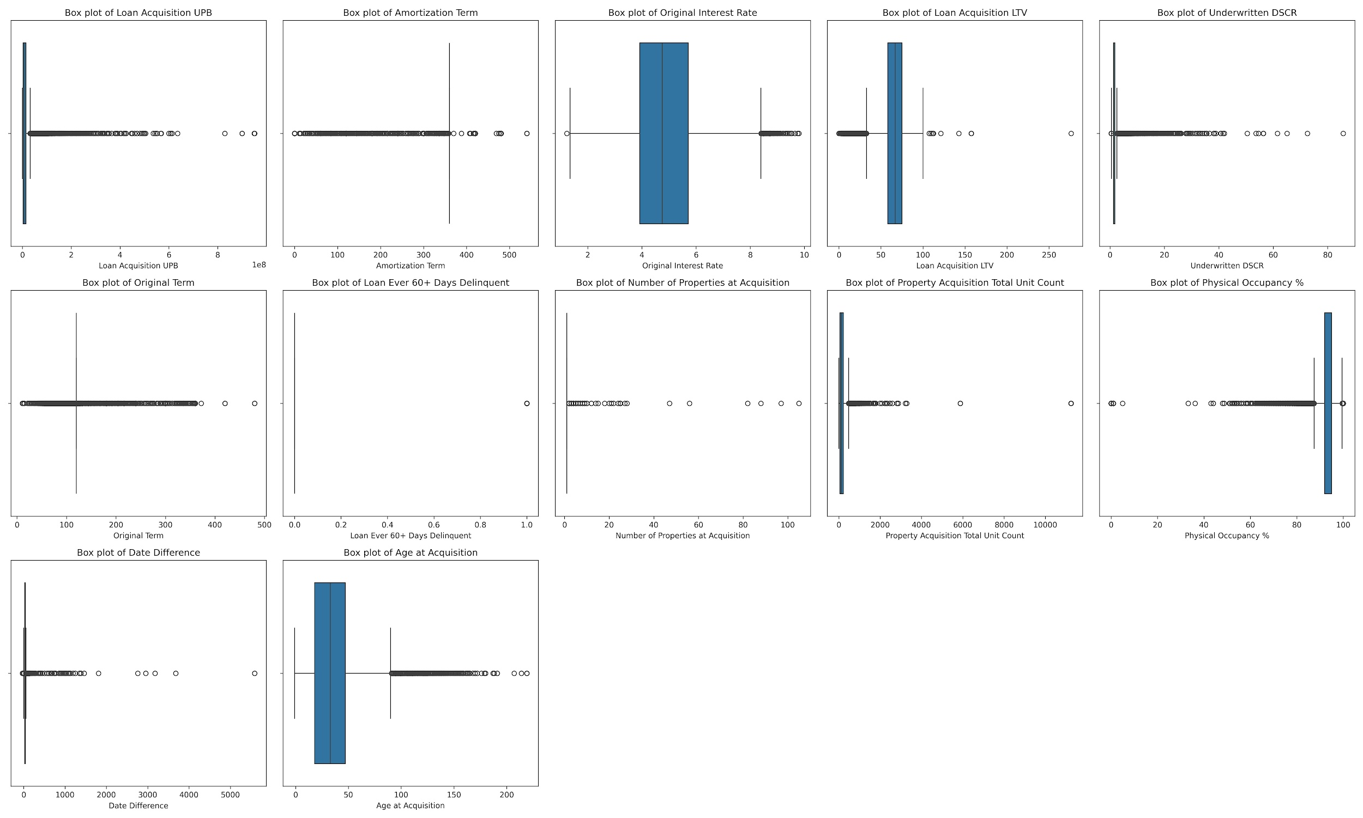
Exploratory Data Analysis - Outliers
Many outliers
Cannot be removed
Volume impacted
Z-scores
Notes:
The last step completed in the exploratory data analysis to guarantee a dataset fit for modeling, is to test for outliers within numeric variables. An outlier is what will skew the distribution and potentially train the model incorrectly. The visualization you see here suggests that all numeric features have quite a few outliers. This is likely due to the large timer period being analyzed and the nature of large datasets. Using a z-score threshold of 3 standard deviations, outliers are recognized and removed. Upon removal, there are still datapoints that appear as outliers in a box and whisker distribution, however performing a second round of removals will significantly change the data that is being worked with and ultimately provide completely different results. After the z-score removal, the reduced dataset recorded just over 58,000 records, the finalized dataset before model preparation and training.

Slide 8
Preprocessing, Feature Engineering, and Data Splitting
Feature Creation:
Replaced date features with age or month counts
Combined indicators
Handling Missing Data:
Categorical values are imputed with the mode
Numerical values are imputed with the median
Removed features with less than 25% data coverage
Data Splitting:
Stratified Split
80/20 Split for Training/Testing
Notes:
Feature Creation:
Replaced date features with age or month counts to avoid influence from historical events.
Combined indicators (Affordable Housing, Social Bond, Green Bond) have been added to a new feature: Special Program.
Handling Missing Data:
Categorical values are imputed with the mode, sometimes by subgroup.
Numerical values are imputed with the median due to skewed distributions.
Removed features with less than 25% data coverage, particularly those not applicable to older loans.
Data Splitting:
A stratified split maintained class proportions in training and testing datasets.
A 20/80 split was applied to ensure adequate representation of the target feature during testing.

Slide 9

Model Strategies
Developed a machine learning pipeline to predict loan defaults using Fannie Mae's multifamily housing data.
Addressed complexities: numeric/categorical variables and target variable imbalance ("Loan Ever 60+ Days Delinquent").
Standardized numeric features to ensure a consistent model contribution.
Used SMOTE to balance the target variable and reduce model bias.

Slide 10
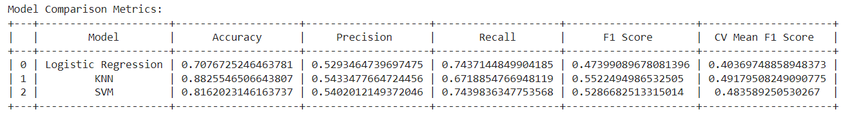




Model Evaluation and Selection
Model Selection – K-Nearest Neighbors
Precision
F1 Score
Align with business goals and accounting for unbalanced target variable

Slide 11
Data Limitations
Dataset posed challenges due to data imbalance
Additional positive default records could enhance model accuracy
Future improvement: Incorporate a feature reflecting economic conditions at the time of loan acquisition
Notes:
Dataset posed challenges due to data imbalance
Additional positive default records could enhance model accuracy
Eliminated date-related information to avoid influence from historical events
Future improvement: Incorporate a feature reflecting economic conditions at the time of loan acquisition

Slide 12
Conclusion
Developed a robust machine learning pipeline to predict loan defaults.
K-Nearest Neighbors (KNN) model achieved the highest precision.
Addressed challenges like data imbalance with SMOTE and avoided information leakage.
Limitations: Need for more positive defaults and integration of economic data.
Future: Explore advanced models to improve accuracy.

